Slide 1
Database Management System (DBMS)
Dr. Ankita Srivastava

Slide 2
Unit 1
Introduction: Overview, Database System vs File System, Database System Concept and Architecture, Data Model Schema and In-stances, Data Independence and Database Language and Interfaces, Data Definitions Language, DML, Overall Database Structure.
Data Modeling Using the Entity Relationship Model : ER Model Concepts, Notation for ER Diagram, Mapping Constraints, Keys, Concepts of SuperKey, Candidate Key, Primary Key, Generalization, Aggrega-tion, Reduction of an ER Diagrams to Tables, Extended ER Model, Relationship of Higher Degree.

Slide 3
TextBooks
Korth, Silbertz, Sudarshan,” Database System Concepts”, McGraw Hill
Elmasri,Navathe,“Fundamentals of Database Systems”, Addision Wesley

Slide 4
Database
It is a collection of interrelated data of an enterprise in a particular subject.
It is a collection of data in an organized manner in a persistent media so that storing and retrieving data will be easier.
For example, a university database might contain information about the following:-
Entities such as students, faculty, courses, and classrooms.
Relationships between entities such as students’ enrollment in courses, faculty teaching courses, and the use of rooms for courses.

Slide 5
Database Management System (DBMS)
It is a collection of programs (software), which is used to create, manipulate (insert, delete, retrieve, update) data in database.
The primary goal of a DBMS is to provide away to store and retrieve database information that is both convenient and efficient.

Slide 6
Applications of DBMS
Databases are widely used. Here are some representative applications:
Banking
Railway reservation system
Airlines
Universities
Credit card transactions
Telecommunication
Sales
Human resources
Hospital system
Hotel system

Slide 7
Drawbacks of File System
To keep information in such file-processing system, there are a number of major disadvantages:-
Data redundancy
Data inconsistency
Difficulty in accessing data
Data isolation
Integrity problems
Atomicity Problem
Concurrent-access anomalies
Security Problems

Slide 8
Advantages of DBMS over File System
No redundant data
Data Consistency and Integrity
Data Security:
Privacy
Easy access to data
Easy recovery
Flexible

Slide 9
Disadvantages of DBMS
DBMS implementation cost is high compared to the file system
Complexity: Database systems are complex to understand
Performance: Database systems are generic, making them suitable for various applications. However this feature affect their performance for some applications

Slide 10
Data Abstraction
Data abstraction means to hide the information. To hide the information from some users, three levels of abstraction is used. This architecture has three levels:
1. External level (View Level)
2. Conceptual level (Logical Level)
3. Physical level (Internal Level)

Slide 11
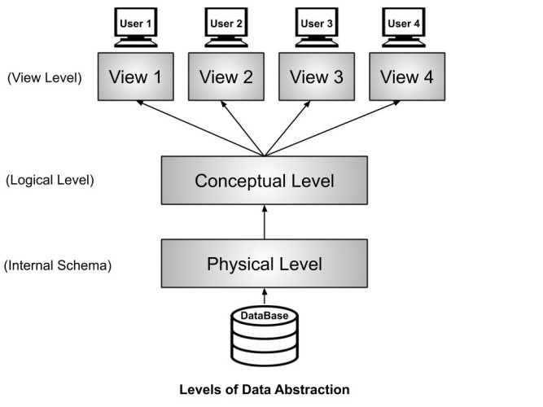

Slide 12
Schema
The overall design of the database is called the database schema.
Schema is of three types: Physical schema, logical schema and view schema.

Slide 13
Physical schema: The design of a database at physical level is called physical schema, how the data stored in blocks of storage is described at this level.
Logical schema: Design of database at logical level is called logical schema, programmers and database administrators work at this level, at this level data can be described.
View schema: Design of database at view level is called view schema. This generally describes end user interaction with database systems.

Slide 14
Advantages of Schema
Data Consistency and Integrity: A well-defined schema enforces rules and constraints (like data types, primary keys, foreign keys, unique constraints, etc.).
Structured Organization of Data: Schema provides a systematic and logical structure to store data.
Simplifies Data Access: By knowing the schema, users and developers can easily query data using SQL, knowing exactly where and how data is stored.
Supports Data Security and Authorization: Schema-level definitions can help in applying access controls and roles, allowing only authorized users to view or manipulate certain parts of the data.
Facilitates Database Design and Documentation: The schema serves as documentation for the database, making it easier to understand its structure and relationships.
Enables Logical and Physical Data Independence: Through logical and physical schema separation, changes in storage details (physical schema) do not affect how users interact with data (logical schema).

Slide 15
Disadvantages of Schema
Rigidity and Inflexibility: Once a schema is defined and implemented, modifying it can be challenging, especially in production environments.
High Complexity in Large Systems: For complex systems with hundreds of tables and relationships, schema design becomes very complex and time-consuming.
Requires Skilled Designers: Designing an optimal schema is not trivial. It demands deep knowledge of data modeling, normalization and performance tuning.
Limited Adaptability to Changing Requirements: If business requirements evolve (e.g., new data fields or relationships), adapting the schema might require schema migration scripts, application code changes and extensive testing, making it less agile.
Overhead in Schema Maintenance: As the database grows and evolves, maintaining the schema can be overhead-heavy, especially when dealing with distributed systems, version control of schema files and synchronization across environments (development, staging, production).
Dependency on Schema Knowledge: Application developers and users must be aware of the schema structure to work effectively with the data.

Slide 16
Instance
The collection of information stored in the database at a particular moment is called an instance of the database.
A database instance is the current data stored in the database.
It is also called the snapshot or state of the database at a specific time.
It changes whenever records are inserted, updated, or deleted.
The schema defines the structure of the database, whereas the instance contains the actual data.

Slide 17
Advantages of Instance
Real-Time Representation of Data: An instance reflects the current state of the database at a specific point in time.
Flexibility in Data Handling: While schemas are rigid and rarely change, instances are highly dynamic.
Supports Day-to-Day Operations: Since instances store actual data, they are essential for performing CRUD operations (Create, Read, Update, Delete) that are part of daily business processes.
Basis for Decision-Making: Instances provide the live data required for data analytics, forecasting, dashboards and reporting tools.
Multiple Instances Over Time Enable History Tracking: Though each instance is a snapshot in time, by capturing them periodically (e.g., through backups or logs), one can recreate historical data trends.

Slide 18
Disadvantages of Instance
Volatile and Continuously Changing: Instances change constantly due to ongoing operations, making it difficult to maintain a consistent view of data over time unless snapshots or backups are taken.
Potential for Data Inconsistency: If constraints (like foreign keys, validations) are not properly enforced, bad or corrupt data can be entered into the instance, leading to inaccurate or inconsistent data.
Difficult to Audit Without Proper Logging: Since data in the instance can change frequently, without audit trails or version control, it may be impossible to track who changed what and when.
Performance Overhead on Frequent Access: Real-time access and updates to instances in large-scale systems can cause performance issues if not properly optimized with indexing, caching or partitioning.
Storage and Memory Concerns: Instances grow as more data is inserted into the database.
Dependent on Schema Integrity: While schema and instance are separate, a poorly designed schema can make instance data difficult to interpret or use.

Slide 19
Difference Between Schema and Instance
Schema | Instance
It is the overall description of the database. | It is the collection of information stored in a database at a particular moment.
The schema is same for the whole database. | Data in instances can be changed using addition, deletion and updation.
Does not change Frequently. | Changes Frequently.
Defines the basic structure of the database i.e. how the data will be stored in the database. | It is the set of Information stored at a particular time.
Affects the entire database structure. | Affects only the current state of data.
Requires significant effort and planning to change. | Easily altered by performing CRUD(Create, Read, Update, Delete) operations.
Table structures, relationships, constraints. | Data entries, records in tables.

Slide 20
Data Independence
Data independence can be explained using the three-schema architecture.
Data independence refers to characteristic of being able to modify the schema at one level of the database system without altering the schema at the next higher level.
There are two types of data independence:
Logical data independence
Physical data independence

Slide 21
Logical Data Independence
Logical data independence refers characteristic of being able to change the conceptual schema without having to change the external schema.
Logical data independence is used to separate the external level from the conceptual view.
If we do any changes in the conceptual view of the data, then the user view of the data would not be affected.

Slide 22
Physical Data Independence
Physical data independence can be defined as the capacity to change the internal schema without having to change the conceptual schema.
If we do any changes in the storage size of the database system server, then the Conceptual structure of the database will not be affected.
Physical data independence is used to separate conceptual levels from the internal levels.
Physical data independence occurs at the logical interface level.

Slide 23
Database Language
Database languages are specialized tools used to interact with databases, mainly through SQL, which is divided into four categories:
DDL,
DML,
DCL,
TCL.
These languages define, manipulate, control, and manage data and database structures.

Slide 24
Data Definition Language
DDL (Data Definition Language) Defines and modifies database schema and structure.
Commands: CREATE, ALTER, DROP, TRUNCATE, RENAME

Slide 25
1. CREATE :
The create command is used to create a table.
A table name should be unique, i.e., it must not match with existing tables.
A table name and column name must start with alphabet, must not match with reserved keywords, and should be combination of A-Z, a-z, 0-9, and ’ ’ (underscore) having maximum length up to 30 characters.
Each column definition requires name, data type and size for that column.
Table name and column name are not case sensitive generally . But if they are enclosed within double quotes, then they are case sensitive.
Each column definition is separated from other by a ’,’ (comma).
The entire SQL statement is terminated with ’;’ (semi colon)

Slide 26
Syntax:
CREATE TABLE tablename( columnName1 datatype(size),columdatatype(size),.............., columnNameN datatype(size));
Example: CREATE TABLE Students (ID INT, Name VARCHAR(50));

Slide 27
2. ALTER :
• Alter command used to modify structures of a table.
• Alter command can be used to add ,modify, or drop columns in a table.
• Alter command can be used for this purpose are described below:
A. Adding New Columns : This command adds a new columns in an existing table. Initially, this column will not contain any data. If required, data can be filled for this column using UPDATE command.
Syntax: Alter table TableName Add (NewColumnName Datatype(size), NewColumnName Datatype(size). . . .);

Slide 28
B. Dropping Columns : This command deletes an existing column from the table along with the data held by that column.
Syntax: Alter table TableName Drop column columnName;
C. Modifying Columns : The main aim of this command is to modify or change the datatype and size of the column.
Syntax : Alter table TableName Modify(columnName newDatatype(newSize));

Slide 29
3. DROP :
DROP TABLE command is used to delete or destroy table from a database.
The DROP TABLE command drops the specified table. This means, all records along with structure of the table will be destroyed.
Care must be taken while using this command, as all records held within the table are lost and cannot be recovered.
Syntax : drop table tablename;

Slide 30
4. TRUNCATE :
TRUNCATE TABLE is used to delete all data from a table.
Logically, this is equivalent to DELETE statement that deletes all rows without using WHERE clause.
TRUNCATE operation drops and re-creates the table. This is must faster than deleting all rows one by one.
The deleted records cannot be recovered in truncate operation. while in delete operation, deleted records can be recovered using ROLLBACK statement.
Syntax : truncate table tablename;

Slide 31
Data Manipulation Language
DML (Data Manipulation Language) deals with data inside tables.
Data manipulation is
• The retrieval of information stored in the database (SELECT)
• The insertion of new information into the database (INSERT)
• The deletion of information from the database (DELETE)
• The modification of information stored in the database (UPDATE)
Example: INSERT INTO Students VALUES (1, 'Rahul');

Slide 32
A data manipulation language (DML) is a language that enables users to access or manipulate data as organized by the appropriate data model.
There are basically two types:
Procedural DMLs require a user to specify what data are needed and how to get those data.
Declarative DMLs (also referred to as non-procedural DMLs) require a user to specify what data are needed without specifying how to get those data.
A query is a statement requesting the retrieval of information. The portion of a DML that involves information retrieval is called a query language.

Slide 33
1. INSERT :
The INSERT command is used insert the data into a table or create a new row in table.
To insert user data into tables, ”INSERT INTO ...” SQL statement is used. and stores the inserted values into respective columns.
Syntax : insert into tablename (column1, column2, columnN) Values (expression1, expression2, ... , expressionN);

Slide 34
2. SELECT :
The SELECT command is used to retrieve selected rows from one or more tables and displays on the screen. It is most widely used and required statement among all others in SQL.
Once a table is loaded with user data, these data can be retrieved in number of different manners.
Here, an asterisk (’ * ’) is used as the meta character, and it indicates all the columns of a given table.
This statement retrieves all the columns and all the rows of the table. Syntax : select * from tablename;

Slide 35
There are three ways of table data filtering as given below:
(A) Selected columns, All Rows
(B) Selected Rows, All Columns
(C) Selected columns, Selected Rows
A. SELECTED COLUMNS, ALL ROWS
This Statement retrieves only selected columns as specified with SELECT clause. This Statement retrieves all the row of the table.
Syntax : select column1, column2, ..., columnN from tablename;

Slide 36
B. SELECTED ROWS, ALL COLUMNS
This Statement retrieves all the columns of the table.
This statement retrieves only specific rows that specify the condition given with WHERE clause.
Multiple conditions can be combined with logical operators such as AND and OR.
Syntax : select * from tablename WHERE condition;

Slide 37
C. SELECTED ROWS, SELECTED COLUMNS
This Statement retrieves only Selected columns as specified with SELECT clause.
Also, retrieves only specific rows that specify the condition given with WHERE clause.
Syntax : select column1, column2, ..., columnN from tablename WHERE condition;

Slide 38
3. UPDATE :
• The UPDATE command can be used to change or modify the data values in a table.
• It can be used to update either all rows or a set of rows from a table.
• The SET clause specifies which column data to modify.
• An expression can be a constant value, a variable, or some expression and it specifies the new value for related columns.
• You can update specific rows by the WHERE clause, and displays message regarding how many rows have been updated.
Syntax :
update tablename
set column1=expression1,
column2=expression2 where condition;

Slide 39
Example
Table: Student
Increase Rahul's marks from 78 to 82.
Change Priya's branch to CSE and marks to 90.
Increase everyone's marks to 100.
StudentID | Name | Branch | Marks
101 | Rahul | CSE | 78
102 | Priya | IT | 85
103 | Aman | ECE | 72

Slide 40
Answers
UPDATE Student SET Marks = 82 WHERE StudentID = 101;
UPDATE Student SET Branch = 'CSE', Marks = 90 WHERE StudentID = 102;
UPDATE Student SET Marks = 100;
UPDATE Student SET Marks = Marks + 5;

Slide 41
4. DELETE :
The DELETE command can be used to remove either all rows of a table, or a set of rows from a table.
The DELETE command deletes rows from the table that satisfy the condition provided by WHERE clause. It also displays message regarding how many rows have been deleted.
Syntax :
DELETE FROM table_name WHERE condition;

Slide 42
Example
Table: Student
Delete the student whose StudentID is 103.
Delete all students from the CSE branch.
StudentID | Name | Branch | Marks
101 | Rahul | CSE | 82
102 | Priya | IT | 90
103 | Aman | ECE | 72
104 | Neha | CSE | 65

Slide 43
DELETE FROM Student WHERE StudentID = 103;
DELETE FROM Student WHERE Branch = 'CSE';

Slide 44
Difference between Delete, Truncate and Drop
Feature | DELETE | TRUNCATE | DROP
Removes | Selected rows or all rows | All rows | Entire table
WHERE clause | Yes | No | No
Table structure remains | Yes | Yes | No
DML/DDL | DML | DDL | DDL

Slide 45
Data Control Language (DCL)
Data Control Language(DCL) is used to control privileges in Database.
To perform any operation in the database, such as for creating tables or views, a user needs privileges.
In DCL, we have following two commands:
GRANT: It is used to provide any user access privileges or other priviliges for the database.
REVOKE: It is used to take back permissions from any user.

Slide 46
Transaction Control Language(TCL)
Transaction Control Language(TCL) commands are used to manage transactions in the database.
These are used to manage the changes made to the data in a table by DML statements.
In TCL, we have following three commands:
COMMIT Command: COMMIT command is used to permanently save any transaction into the database. When we use any DML command like INSERT, UPDATE or DELETE, the changes made by these commands are not permanent, until the current session is closed. The changes made by these commands can be rolled back. To avoid that, we use the COMMIT command to mark the changes as permanent. Following is commit command’s syntax,
COMMIT;

Slide 47
ROLLBACK command : This command restores the database to last commited state. It is also used with SAVEPOINT command to jump to a savepoint in an ongoing transaction.
If we have used the UPDATE command to make some changes into the database, and realise that those changes were not required, then we can use the ROLLBACK command to rollback those changes, if they were not commited using the COMMIT command.
Following is rollback command’s syntax,
ROLLBACK TO savepoint name;
SAVEPOINT command: SAVEPOINT command is used to temporarily save a transaction so that you can rollback to that point whenever required.
Following is savepoint command’s syntax,
SAVEPOINT savepoint name;

Slide 48
Example
The class table contains the attributes id and name.
Write SQL commands to:
Insert the record (5, 'Rahul').
Commit the transaction.
Update Rahul's name to Abhijit.
Create a savepoint A.
Insert the record (6, 'Chris').
Create savepoint B.
Insert the record (7, 'Bravo').
Create savepoint C.
Display all records from the table.

Slide 49
Solution
INSERT INTO class VALUES (5, 'Rahul');
COMMIT;
UPDATE class
SET name = 'Abhijit'
WHERE id = 5;
SAVEPOINT A;
INSERT INTO class VALUES (6, 'Chris');
SAVEPOINT B;
INSERT INTO class VALUES (7, 'Bravo');
SAVEPOINT C;
SELECT * FROM class;

Slide 50
Comparison Table
Language | Purpose | Key Commands | Focus
DDL | Define structure | CREATE, ALTER, DROP | Schema objects
DML | Manage data | SELECT, INSERT, UPDATE, DELETE | Table records
DCL | Control access | GRANT, REVOKE | User privileges
TCL | Manage transactions | COMMIT, ROLLBACK, SAVEPOINT | Transaction integrity

Slide 51
Database Users and Administrators
People who work with a database can be categorized as database users or database administrators.
Database Users :
There are four different types of database-system users, differentiated by the way they expect to interact with the system.
Different types of user interfaces have been designed for the different types of users.

Slide 52
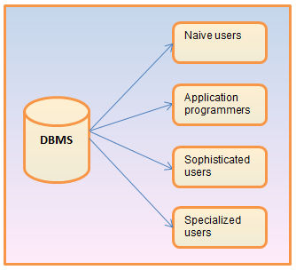

Slide 53
Naive users/Parametric users:
Naive users are unsophisticated users who interact with the system by invoking one of the application programs that have been written previously.
For example, a bank teller who needs to transfer $50 from account A to account B invokes a program called transfer.
Application programmers:
Application programmers are computer professionals who write application programs.
Application programmers can choose from many tools to develop user interfaces. Rapid application development (RAD) tools are tools that enable an application programmer to construct forms and reports without writing a program.

Slide 54
Sophisticated users:
Sophisticated users interact with the system without writing programs. Instead, they form their requests in a database query language.
They submit each such query to a query processor, whose function is to break down DML statements into instructions that the storage manager understands.
Analysts who submit queries to explore data in the database fall in this category. They use some of the tools like Online Analytical Processing(OLAP), Data mining.

Slide 55
Specialized users:
Specialized users are sophisticated users who write specialized database applications that do not fit into the traditional data-processing framework.
Among these applications are computer-aided design systems, knowledge base and expert systems, systems that store data with complex data types (for example, graphics data and audio data), and environment-modeling systems.

Slide 56
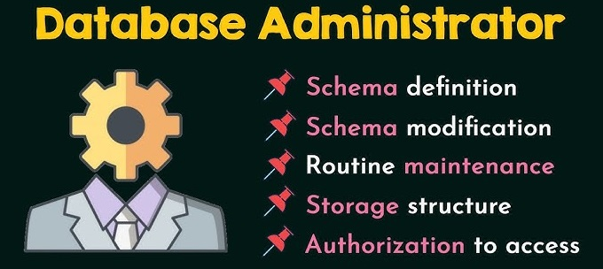
Database Administrator
A person who has such central control of both the data and the programs that access those data over the system is called a database administrator (DBA).

Slide 57
The functions of a DBA are the followings:-
Schema definition:
The DBA creates the original database schema by executing a set of data definition statements in the DDL.
Schema and physical-organization modification:
The DBA carries out changes to the schema and physical organization to reflect the changing needs of the organization, or to alter the physical organization to improve performance.
Routine maintenance:
Examples of the database administrator’s routine maintenance activities are:
Periodically backing up the database, either onto tapes or onto remote servers, to prevent loss of data in case of disasters such as flooding.
Ensuring that enough free disk space is available for normal operations, and upgrading disk space as required.
Monitoring jobs running on the database and ensuring that performance is not degraded by very expensive tasks submitted by some users.

Slide 58
Storage structure and access-method definition:
DBA decides what structure to be used to store the data and what method to be used to access that.
Granting of authorization for data access:
By granting different types of authorization, the database administrator can regulate which parts of the database various users can access.

Slide 59
Data Model
A data model is a collection of concepts used to describe the structure of a database, the relationships among data, and the constraints on the data.
A data model is a logical framework that defines how data is stored, organized, related, and manipulated in a database.
Data models define how data is connected to each other and how they are processed and stored inside the system.

Slide 60
Types of Data Models
There are different types of data models are used in DBMS. Here, we are going to explain some data models.
(1) Entity relationship model
(2) Relational model
(3) Network model
(4) Hierarchical model

Slide 61
Entity-Relationship (ER) Model
The Entity-Relationship (ER) Model is a high-level conceptual data model used to design the structure of a database.
It represents
real-world objects as entities,
their properties as attributes, and
the associations between them as relationships.
It is mainly used during the database design phase, before creating tables in a relational database.

Slide 62
Components of the ER Model
1. Entity
An entity is a real-world object, person, place, event, or thing about which data is stored.
Examples:
Student
Employee
Book
Department
Symbol: Rectangle

Slide 63
2. Attribute
An attribute is a property or characteristic of an entity.
For example, the Student entity may have:
Roll Number
Name
Age
Email
Symbol: Oval (Ellipse)
Roll_No
Name

Slide 64
Types of Attributes
a) Simple Attribute
Cannot be divided further.
Example: Age, Gender
b) Composite Attribute
Can be divided into smaller attributes.
Example:
Name ├── First Name ├── Middle Name └── Last Name
c) Single-Valued Attribute
Has only one value for each entity.
Example: Roll Number, Date of Birth

Slide 65
d) Multi-Valued Attribute
Can have multiple values.
Example:
Phone Numbers
Email Addresses
Represented by a double oval.
e) Derived Attribute
Can be calculated from another attribute.
Example:
Age (derived from Date of Birth)
Represented by a dashed oval.

Slide 66
3. Relationship
A relationship shows how two or more entities are associated.
Example: A student enrolls in a course.
Student -------- Enrolls -------- Course
Symbol: Diamond
Enrolls
Student
Course

Slide 67
4. Cardinality (Mapping Constraints)
Cardinality specifies how many instances of one entity are related to another.
a) One-to-One (1:1)
One person has one passport.
Person -------- Passport
b) One-to-Many (1:M)
One department has many employees.
Department -------- Employee
c) Many-to-One (M:1)
Many students belong to one department.
Student -------- Department
d) Many-to-Many (M:N)
Students can enroll in many courses, and each course can have many students.
Student -------- Course

Slide 68
5. Participation Constraints
Total Participation
Every entity must participate in the relationship.
Example: Every employee must belong to a department.
Represented by a double line.
Partial Participation
Participation is optional.
Example: Not every employee is assigned a company car.
Represented by a single line.

Slide 69
What is a Strong Entity Set?
A Strong Entity Set is an entity set that has its own primary key and can be uniquely identified without depending on any other entity.
A strong entity set is an entity that has a primary key and can exist independently.

Slide 70
Characteristics of a Strong Entity Set
Has its own Primary Key.
Can exist independently.
Does not depend on another entity.
Represented by a single rectangle in an ER diagram.

Slide 71
Example
Since Student_ID is sufficient to identify every student,
Student is a Strong Entity Set.
Student_ID | Name | Branch
101 | Rahul | CSE
102 | Anita | ECE
103 | Mohit | AI

Slide 72
What is a Weak Entity Set?
A Weak Entity Set is an entity that does not have enough attributes to form its own primary key. It depends on another (strong) entity for identification and existence.
A weak entity set is an entity that cannot be uniquely identified by its own attributes and depends on a strong entity for its identification.

Slide 73
Characteristics of a Weak Entity Set
Has no complete primary key.
Depends on a strong entity.
Cannot exist independently.
Uses a partial key (discriminator) together with the strong entity's key.
Represented by a double rectangle in an ER diagram.

Slide 74
Example : Employee and Dependent
Suppose an employee has family members.
Employee (Strong Entity)
Employee_ID (PK)
Name
Department
Salary
Dependent (Weak Entity)
Dependent_Name
Age
Relation
Employee_ID | Employee | Dependent_Name
101 | Rahul | Riya
102 | Amit | Riya

Slide 75
Identifying Relationship
The relationship connecting a weak entity to its owner (strong entity) is called the Identifying Relationship.
It is represented by a double diamond.
The identifying relationship ensures that every dependent belongs to an employee.

Slide 76
Partial Key (Discriminator)
A partial key is an attribute of a weak entity that distinguishes it within the context of its owner, but not globally.
In the Dependent example:
Dependent_Name is a partial key.
It is unique only for a particular employee.
For example:
Employee 101
Dependent_Name
Riya
Rohan

Slide 77
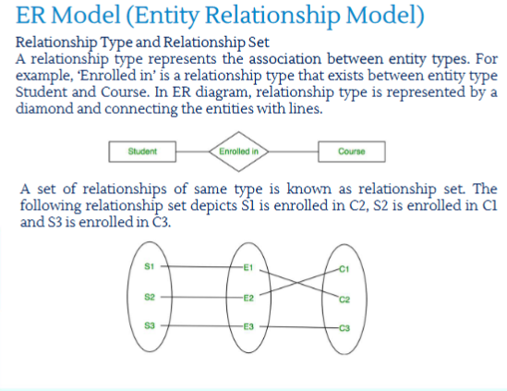

Slide 78
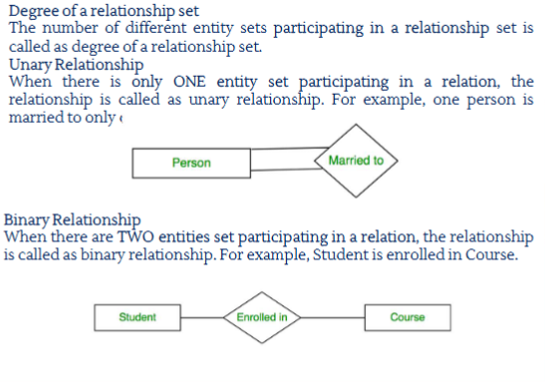

Slide 79
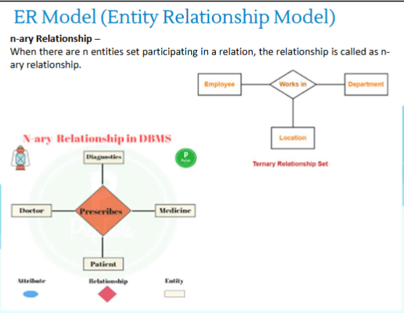

Slide 80
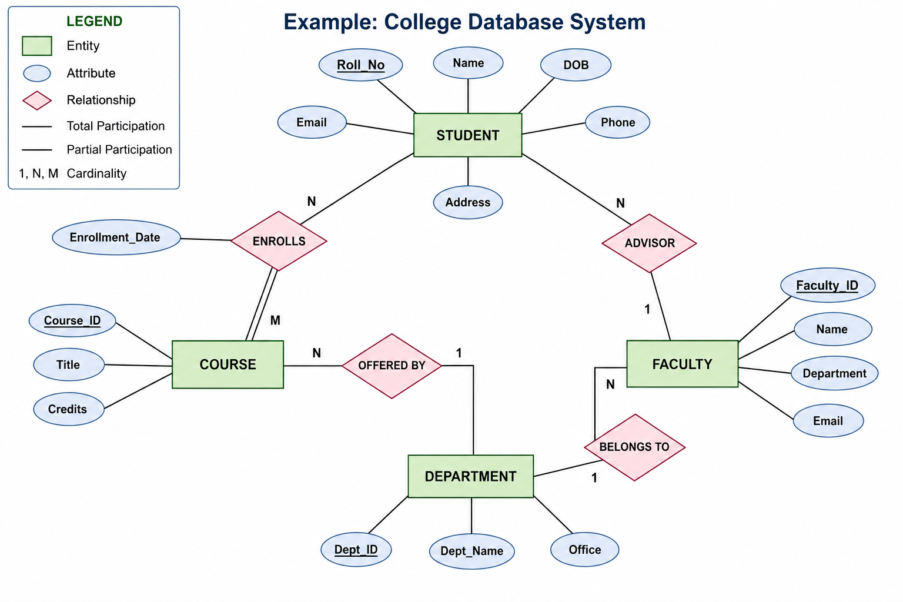
Example

Slide 81
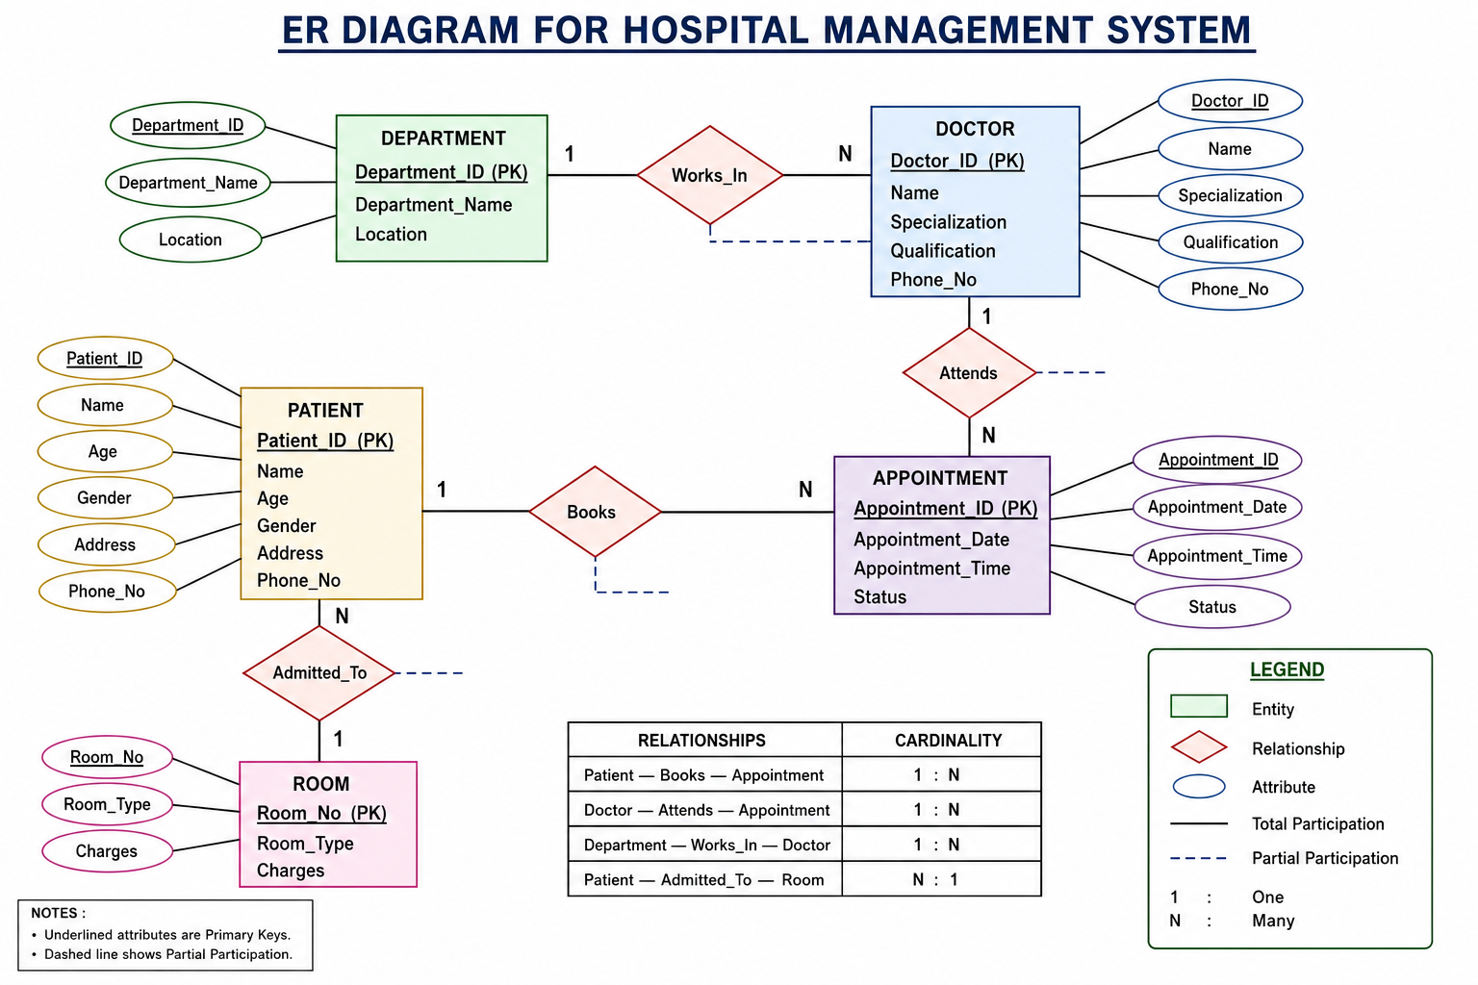

Slide 82
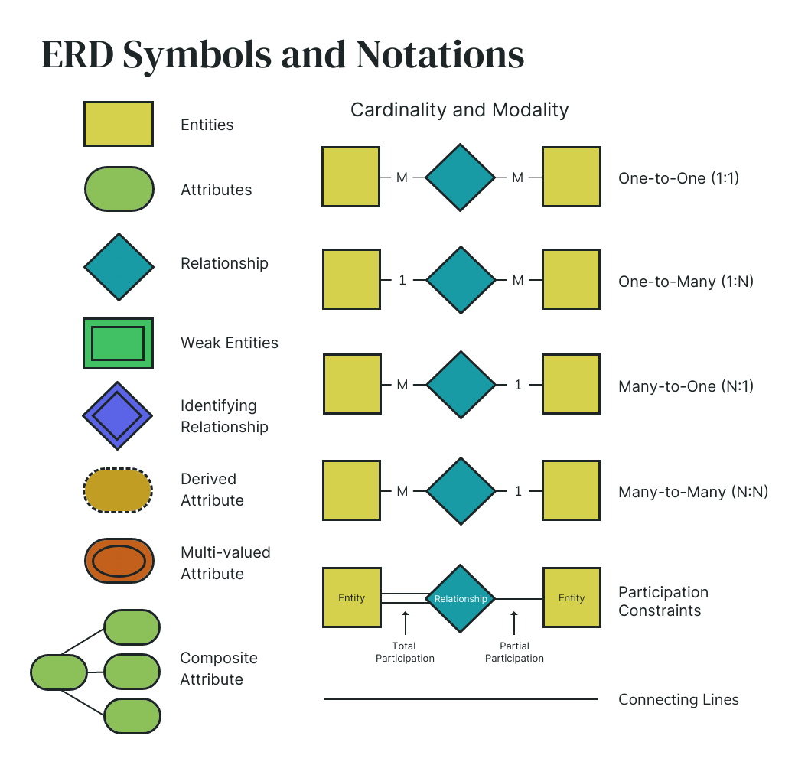

Slide 83
Relational Model
The Relational Model is a logical data model proposed by Dr. E. F. Codd in 1970. It organizes data into tables (called relations) consisting of rows (tuples) and columns (attributes).
Relationships between tables are established using primary keys and foreign keys.
** The relational model is a database model in which data is stored in the form of tables (relations), and relationships among tables are established using keys.

Slide 84
1. Relation (Table)
A relation is a table that stores data.
Example: STUDENT
Here, STUDENT is a relation.
Roll_No | Name | Age | Department
101 | Rahul | 20 | CSE
102 | Priya | 21 | AI

Slide 85
2. Attribute (Column)
An attribute is a column in a table that describes a property of an entity.
Example: Attributes are:
Roll_No
Name
Age
3. Tuple (Row)
A tuple is a single row (record) in a table.
Example:
This row is one tuple.
Roll_No | Name | Age
101 | Rahul | 20

Slide 86
4. Domain
A domain is the set of all possible valid values that an attribute can have.
Example:
5. Degree
The degree of a relation is the number of attributes (columns).
Example:
| Roll_No | Name | Age | Email |
There are 4 columns, so the degree = 4.
Attribute | Domain
Age | 0–120
Gender | Male, Female, Other
Credits | 1–6

Slide 87
6. Cardinality
The cardinality of a relation is the number of tuples (rows).
Example:
There are 3 rows, so the cardinality = 3.
Roll_No | Name
101 | Rahul
102 | Priya
103 | Aman

Slide 88
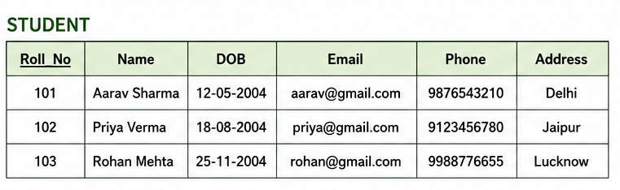
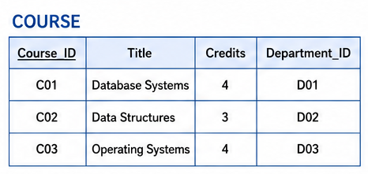
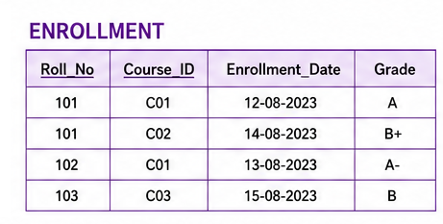
Example

Slide 89
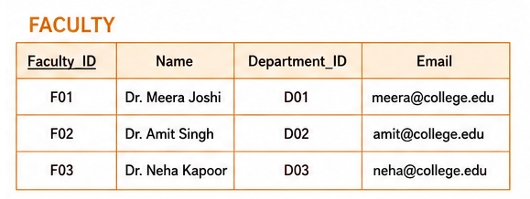
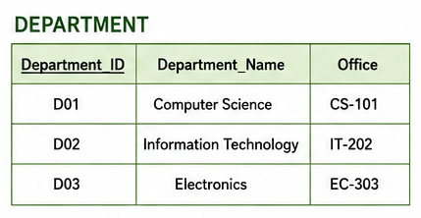

Slide 90
Concept of Keys in DBMS
A key in DBMS is an attribute (column) or a set of attributes that is used to uniquely identify a record (row) in a table and to establish relationships between tables.
Keys help maintain:
Uniqueness of records
Data integrity
Relationships among tables
Efficient searching and indexing

Slide 91
Example Database
STUDENT Table
Student_ID | Roll_No | Name | Email | Phone | Branch
101 | CS001 | Amit | amit@gmail.com | 9876543210 | CSE
102 | CS002 | Priya | priya@gmail.com | 9876543211 | CSE
103 | EC001 | Rahul | rahul@gmail.com | 9876543212 | ECE
104 | ME001 | Neha | neha@gmail.com | 9876543213 | ME

Slide 92
1. Super Key
A Super Key is any attribute or combination of attributes that can uniquely identify each record in a table.
A super key may contain extra attributes that are not necessary for uniqueness.
Example
In the STUDENT table, Possible Super Keys are:
Student_ID
Roll_No
Email
Student_ID + Name
Student_ID + Phone
Roll_No + Branch
Email + Name
All these combinations uniquely identify each student.

Slide 93
2. Candidate Key
A Candidate Key is the smallest possible Super Key.
It contains no unnecessary attribute.
Example
Possible Candidate Keys:
Student_ID
Roll_No
Email
Each one uniquely identifies students without extra columns.
These are minimal.

Slide 94
3. Primary Key
The Candidate Key chosen by the database designer to identify records uniquely is called the Primary Key.
Properties:
Unique
Cannot be NULL
Only one Primary Key per table
Example
Student_ID is selected as Primary Key.
Syntax
CREATE TABLE STUDENT
(
Student_ID INT PRIMARY KEY,
Name VARCHAR(30),
Branch VARCHAR(20)
);

Slide 95
4. Alternate Key
Candidate Keys that are not selected as the Primary Key are called Alternate Keys.
Example
Candidate Keys:
Student_ID
Roll_No
Email
Suppose Student_ID is selected as Primary Key.
Then
Alternate Keys are
Roll_No
Email

Slide 96
5. Composite Key (Compound Key)
A key made up of two or more attributes together is called a Composite Key.
Neither attribute alone is sufficient.
Example
ENROLLMENT Table
Student_ID | Course_ID | Marks
101 | C101 | 88
101 | C102 | 92
102 | C101 | 76

Slide 97
Syntax:
CREATE TABLE ENROLLMENT
(
Student_ID INT,
Course_ID VARCHAR(10),
Marks INT,
PRIMARY KEY(Student_ID, Course_ID)
);

Slide 98
6. Foreign Key
Foreign Key is an attribute in one table that refers to the Primary Key of another table.
It creates relationships between tables.
Example
DEPARTMENT Table
STUDENT Table
Dept_ID | Dept_Name
10 | CSE
20 | ECE
30 | ME
Student_ID | Name | Dept_ID
101 | Amit | 10
102 | Priya | 10
103 | Rahul | 20

Slide 99
Syntax:
CREATE TABLE DEPARTMENT
(
Dept_ID INT PRIMARY KEY,
Dept_Name VARCHAR(30)
);
CREATE TABLE STUDENT
(
Student_ID INT PRIMARY KEY,
Name VARCHAR(30),
Dept_ID INT,
FOREIGN KEY(Dept_ID)
REFERENCES DEPARTMENT(Dept_ID)
);

Slide 100
Hierarchical Database Model (DBMS)
The Hierarchical Database Model is one of the earliest database models in which data is organized in the form of a tree structure.
It consists of Parent and Child nodes.
Each parent can have multiple children.
Each child can have only one parent.
The topmost node is called the Root.
In Simple terms, The Hierarchical Database Model is a database model in which data is organized in a tree-like structure where each parent record can have many child records, but each child record has only one parent.

Slide 101
Real Life Example
Think of a Family Tree
Grandfather
|
-------------------
| |
Father Uncle
|
-----------------
| |
Son Daughter

Slide 102
Database Example
Suppose a university stores information about Departments and Students.
DEPARTMENT
STUDENT
Dept_ID | Department
10 | Computer Science
20 | Electronics
Student_ID | Name | Dept_ID
101 | Amit | 10
102 | Priya | 10
103 | Rahul | 20
104 | Neha | 20

Slide 103
University
|
--------------------------------
| |
Computer Science Electronics
| |
------------------ ----------------
| | | |
Amit Priya Rahul Neha
Here,
University is the Root.
Departments are Parent nodes.
Students are Child nodes.
Each student belongs to only one department.

Slide 104
Components of Hierarchical Model
1. Root Node
The topmost node.
Example:
University
2. Parent Node
A node that has one or more child nodes.
Example:
Computer Science
3. Child Node
A node that is connected below a parent.
Example:
Amit
4. Leaf Node
A node that has no children.
Example:
Amit Priya Rahul Neha

Slide 105
Characteristics
Data is stored in a tree structure.
Supports one-to-many relationships.
Every child has only one parent.
Navigation starts from the root.
Parent must exist before adding a child.

Slide 106
Advantages
1. Simple Structure
Easy to understand because it resembles a tree.
2. Fast Data Retrieval
Data can be accessed quickly by following the tree path.
3. Good Data Integrity
Every child is connected to exactly one parent.
4. Efficient for One-to-Many Relationships
Example:
One Department → Many Students

Slide 107
Disadvantages
1. No Many-to-Many Relationship
2. Difficult to Modify
Changing the hierarchy often requires restructuring the database.
3. Data Redundancy
If the same child belongs under multiple parents, the child's information may need to be duplicated.
4. Navigation is Path-Dependent
To reach a child, you must follow the path from the root.

Slide 108
Real-World Applications
Organization charts (CEO → Managers → Employees)
File systems (Folders → Subfolders → Files)
XML documents
DNS (Domain Name System)
Library classification systems

Slide 109
Network Database Model
The Network Database Model is a database model in which data is organized as a network (graph) rather than a tree.
In this model, a child record can have multiple parent records, making it more flexible than the Hierarchical Model.

Slide 110
Why was the Network Model introduced?
The Hierarchical Model has one major limitation:
A child can have only one parent.
The Network Model solves this problem by allowing child to be connected to multiple parents.

Slide 111
Online Shopping System
Suppose:
Customers purchase multiple products.
Products are purchased by multiple customers.
CUSTOMER Table
PRODUCT Table
Customer_ID | Name
C101 | Amit
C102 | Priya
Product_ID | Product_Name
P101 | Laptop
P102 | Mobile

Slide 112
ORDERS Table
Customer_ID | Product_ID
C101 | P101
C101 | P102
C102 | P101

Slide 113
Network Represesntation
Laptop
/ \
/ \
Amit Priya
\
\
Mobile
Here,
Amit purchases Laptop and Mobile.
Priya purchases Laptop.
The product Laptop has two parent relationships.

Slide 114
Components of the Network Model
1. Record
A collection of related data.
Example:
Student
2. Set (Relationship)
A connection between two records.
Example:
Student -------- Course
3. Owner Record
Acts like the parent.
Example:
Course
4. Member Record
Acts like the child.
Example:
Student

Slide 115
Characteristics
Data is organized as a graph.
Supports Many-to-Many relationships.
A child can have multiple parents.
Records are connected using pointers or links.
More flexible than the Hierarchical Model.

Slide 116
Advantages
1. Supports Many-to-Many Relationships
Example:
Many Students ↔ Many Courses
2. Faster Data Access
Records are directly connected through links.
3. Reduces Data Redundancy
The same record does not need to be duplicated under multiple parents.
4. More Flexible
A record can belong to multiple groups.

Slide 117
Disadvantages
1. Complex Structure
The graph structure is more difficult to understand than a tree.
2. Difficult Database Design
Creating and maintaining relationships is more complex.
3. Navigation-Based
The user must know the path to access the required data.
4. Difficult Maintenance
Adding or removing relationships can become complicated in large databases.

Slide 118
Activity
Student
Club
Student_ID | Name
101 | Amit
102 | Priya
103 | Rahul
Club_ID | Club_Name
C1 | Coding Club
C2 | Robotics Club
C3 | Music Club

Slide 119
Membership Table
Student_ID | Club_ID
101 | C1
101 | C2
102 | C2
103 | C1
103 | C3

Slide 120
Questions
Which students belong to more than one club?
Which club has more than one student?
Is this an example of a One-to-Many or Many-to-Many relationship?
Can this relationship be efficiently represented using the Hierarchical Model? Why?
Which database model is more suitable for this scenario?

Slide 121
Extended ER (EER) Model
The Extended Entity Relationship (EER) Model, also known as the Enhanced ER Model, is an advanced version of the traditional ER Model.
It extends the capabilities of the ER model by introducing concepts such as specialization, generalization, inheritance, aggregation, and categories (union types).
The EER model is used when the real-world system is too complex to be represented using only entities, attributes, and relationships.

Slide 122
Why Do We Need the Extended ER Model?
Consider a university database.
In a simple ER model, we can create an entity called Person.
Person
----------------------
Person_ID
Name
Age
Gender
Address
But in reality, a person can be
Student
Faculty
Staff
Each of these has different additional information.
For example,
Student has
Roll Number
Semester
Faculty has
Employee ID
Salary
Staff has
Department
Shift
Representing all these in a single entity would create many NULL values and unnecessary attributes.
The EER Model solves this problem.

Slide 123
Features of the Extended ER Model
The EER model introduces the following concepts:
Superclass
Subclass
Specialization
Generalization
Inheritance
Aggregation
Category (Union Type)

Slide 124
1. Superclass
A Superclass is a general entity that contains common attributes shared by multiple entity types.
Example
Person
--------------------
Person_ID
Name
Age
Gender
Address
Every student, faculty member, and staff member is a person.
Therefore,
Person becomes the superclass.

Slide 125
2. Subclass
A subclass is a specialized entity that inherits all properties of its superclass and also has its own unique attributes.
Example
Person
Staff Student Faculty
Student
Roll_No
Semester
CGPA
Faculty
Employee_ID
Salary
Designation
Staff
Department
Shift
Each subclass automatically gets
Person_ID
Name
Age
Gender
Address

Slide 126
3. Inheritance
Inheritance means
Every subclass automatically inherits all attributes and relationships from its superclass.
Suppose
Person Person_ID Name Age Address
Student inherits
Person_ID Name Age Address Roll_No Semester
Faculty inherits
Person_ID Name Age Address Salary Department
No need to redefine the common attributes.
This reduces redundancy.

Slide 127
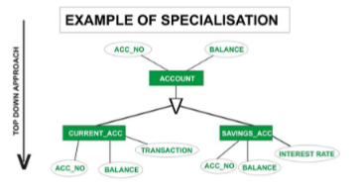
4. Specialization
Specialization is the process of dividing one superclass into multiple subclasses based on distinguishing characteristics.
It is a Top-Down Approach.
Example
Vehicle can be divided into
Car
Bike
Truck
Vehicle contains
Vehicle_ID
Color
Brand
Car contains
No_of_Doors
Fuel_Type
Bike contains
Engine_CC
Truck contains
Load_Capacity

Slide 128
Example
Vehicle
----------------
Vehicle_ID
Color
Manufacturer
|
ISA
_________|__________
| | |
Car Bike Bus
No_of_Doors Engine_CC Seating_Capacity

Slide 129
Types of Specialization
(A) Disjoint Specialization
An entity belongs to only one subclass.
Example
Employee
|
--------------
| |
Professor Clerk
One employee cannot be both Professor and Clerk.
(B) Overlapping Specialization
An entity may belong to multiple subclasses.
Example
Teacher
|
----------------------
| | Researcher Administrator
A teacher can be both.

Slide 130
5. Generalization
Generalization is exactly opposite of specialization.
It is a Bottom-Up Approach.
Instead of breaking one entity into many, we combine many similar entities into one superclass.
Example
Car
Bike
Truck
↓
Vehicle

Slide 131
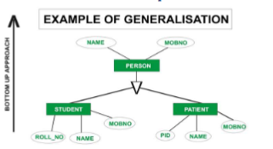

Slide 132
Example
Before:
Car
Vehicle_No
Color
Bike
Vehicle_No
Color
Truck
Vehicle_No
Color
Vehicle_No and Color are repeated
After:
Vehicle
Vehicle_No
Color

Slide 133
Aggregation
Aggregation is a feature of the EER model in which a relationship set is treated as a higher-level entity so that it can participate in another relationship.
In simple words
Normally, Entities participate in relationships.
But sometimes,
A relationship itself needs to participate in another relationship.
Since relationships cannot directly participate in another relationship, we convert (aggregate) the relationship into an entity.
This process is called Aggregation.

Slide 134
Center
Offer
Course
enquire
Visitor

Slide 135
Advantages of the EER Model
Represents complex real-world systems accurately.
Reduces data redundancy through inheritance.
Makes database design modular and organized.
Supports object-oriented concepts.
Improves maintainability and scalability.
Makes large enterprise databases easier to understand.

Slide 136
Limitations
More complex than the basic ER model.
Requires careful design to avoid ambiguity.
EER diagrams become larger and more difficult to interpret for very large systems.

Slide 137
Conversion of ER diagram to Tabular Representation

Slide 138
Tabular Representation of Strong Entity Sets
A strong entity set is an entity that can exist independently and has its own primary key to uniquely identify each record. When converting an ER diagram into relational tables, every strong entity set becomes one relation (table).
Rule for Converting a Strong Entity Set into a Table
For every strong entity set:
Create a separate table.
Include all simple attributes as columns.
Choose the primary key attribute as the Primary Key (PK).
Ignore derived attributes (they are calculated when needed).
If an attribute is composite, split it into its simple attributes.
If an attribute is multivalued, create a separate table for it.

Slide 139
Example
ER Representation
Employee
----------------------------
Emp_ID (Primary Key)
Emp_Name
Designation
Salary
Department
Tabular Representation
Emp_ID (PK) | Emp_Name | Designation | Salary | Department
E101 | Ravi | Manager | 60000 | HR
E102 | Neha | Developer | 50000 | IT
E103 | Mohit | Analyst | 45000 | Finance

Slide 140
Handling Different Types of Attributes
1. Simple Attribute
ER Diagram
Student
|
Name
Table
Stored directly as column
Roll_No | Name
101 | Amit

Slide 141
2. Composite Attribute
Suppose Name consists of:
Name
├── First_Name
├── Middle_Name
├── Last_Name
Instead of storing Name, split it into its components.
Table:
Roll_No | First_Name | Middle_Name | Last_Name
101 | Amit | Kumar | Sharma

Slide 142
3. Derived Attribute
Suppose
Date_of_Birth → Age
Age can be calculated from Date of Birth.
Table
Age is not stored because it changes over time and can be computed whenever needed.
Roll_No | Date_of_Birth
101 | 15-05-2005

Slide 143
4. Multivalued Attribute
Suppose a student has multiple phone numbers.
ER Representation
Student
|
Phone_Number (Multivalued)
Student Table
Student_Phone Table
Roll_No (PK) | Name
101 | Amit
Roll_No (FK) | Phone_Number
101 | 9876543210
101 | 9123456780
101 | 8899776655

Slide 144
Tabular Representation of Weak Entity Sets
A weak entity set is an entity that cannot be uniquely identified by its own attributes. It depends on a strong (owner) entity for its existence and identification.
When converting a weak entity set from an ER diagram to relational tables:
Create a separate table for the strong entity.
Create another table for the weak entity.
Include the primary key of the strong entity in the weak entity table as a foreign key.
The primary key of the weak entity table is the combination of the strong entity's primary key and the weak entity's partial key (discriminator).

Slide 145
Example
ER Diagram
Employee (Strong Entity)
------------------------
Emp_ID (Primary Key)
Emp_Name
Department
Identifying Relationship
│
│
Dependent (Weak Entity)
-----------------------
Dependent_Name (Partial Key)
Age
Relation
An employee can have many dependents.
A dependent cannot exist without an employee.

Slide 146
Employee Table
Dependent Table
Primary Key
(Emp_ID, Dependent_Name)
Because Dependent_Name alone is not unique.
Emp_ID (PK) | Emp_Name | Department
E101 | Ravi | HR
E102 | Neha | IT
Emp_ID (FK) | Dependent_Name (Partial Key) | Age | Relation
E101 | Aman | 10 | Son
E101 | Priya | 35 | Wife
E102 | Mohit | 8 | Son

Slide 147
Tabular Representation of Relationship Sets
A relationship set represents an association between two or more entity sets in an ER model. During ER-to-Relational Model conversion, the way a relationship is represented depends on its cardinality (1:1, 1:N, M:N) and whether it has its own attributes.
General Rules
Relationship Type | Tabular Representation
One-to-One (1:1) | Add the primary key of one entity as a foreign key in the other entity (or create a separate table if the relationship has attributes).
One-to-Many (1:N) | Add the primary key of the "one" side as a foreign key in the "many" side.
Many-to-Many (M:N) | Create a separate relationship table containing the primary keys of both entities.
Relationship with Attributes | Create a separate table including the foreign keys and the relationship attributes.

Slide 148
1. One-to-One (1:1) Relationship
Example
Each Person has one Passport, and each Passport belongs to only one Person.
ER Diagram
Person ---------------- Has ---------------- Passport
1 1
Person Table
Passport Table
Here, Person_ID is stored as a Foreign Key in the Passport table.
Person_ID (PK) | Name | City
P101 | Amit | Delhi
P102 | Priya | Lucknow
Passport_No (PK) | Issue_Date | Person_ID (FK)
A12345 | 15-Jan-2024 | P101
B56789 | 20-Feb-2024 | P102

Slide 149
2. One-to-Many (1:N) Relationship
Example
One Department has many Employees, but each employee belongs to only one department.
ER Diagram
Department -------- Works_For -------- Employee
1 N
Department Table
Employee Table
The foreign key is placed on the many side (Employee).
Dept_ID (PK) | Department_Name
D101 | CSE
D102 | IT
Emp_ID (PK) | Name | Salary | Dept_ID (FK)
E101 | Ravi | 45000 | D101
E102 | Neha | 52000 | D101
E103 | Mohit | 48000 | D102

Slide 150
3. Many-to-Many (M:N) Relationship
Example
A Student can enroll in many Courses, and a Course can have many Students.
ER Diagram
Student -------- Enrolls -------- Course
M N
Student Table
Course Table
Enrollment (Relationship) Table
Primary Key
(Roll_No, Course_ID)
This table stores the relationship between students and courses.
Roll_No (PK) | Name
101 | Amit
102 | Priya
Course_ID (PK) | Course_Name
C101 | DBMS
C102 | AI
Roll_No (FK) | Course_ID (FK)
101 | C101
101 | C102
102 | C101

Slide 151
4. Relationship Set with Attributes
Sometimes a relationship has its own attributes.
Example
A student enrolls in a course, and the relationship stores:
Semester
Grade
ER Diagram
Student ----- Enrolls ----- Course
|
Semester, Grade

Slide 152
Student Table
Course Table
Enrollment (Relationship) Table
Primary Key
(Roll_No, Course_ID)
Roll_No (PK) | Name
101 | Amit
102 | Priya
Course_ID (PK) | Course_Name
C101 | DBMS
C102 | AI
Roll_No (FK) | Course_ID (FK) | Semester | Grade
101 | C101 | 3 | A
101 | C102 | 3 | B+
102 | C101 | 3 | A+

Slide 153
5. Ternary Relationship (Three Entities)
Suppose a Supplier supplies a Product to a Project.
ER Diagram
Supplier
\
Supplies
/ \
Product Project

Slide 154
Supplier Table
Product Table
Project Table
Supplies Table
Primary Key
(Supplier_ID, Product_ID, Project_ID)
Supplier_ID (PK) | Supplier_Name
S101 | ABC Ltd.
Product_ID (PK) | Product_Name
P101 | Laptop
Project_ID (PK) | Project_Name
PR101 | AI Lab
Supplier_ID (FK) | Product_ID (FK) | Project_ID (FK) | Quantity
S101 | P101 | PR101 | 25

Slide 155
Converting Generalization into Tables
Method 1: One Table for Superclass and One Table for Each Subclass (Most Common)
Advantages
No duplication of common attributes.
Easy to maintain.
Most widely used in database design.

Slide 156
Example
SuperClass: Person
Student Table
Faculty Table
Person_ID (PK) | Name | Address | Phone
P101 | Amit | Delhi | 9876543210
P102 | Neha | Lucknow | 9988776655
P103 | Ravi | Kanpur | 9876501234
Person_ID (PK, FK) | Roll_No | Branch | Semester
P101 | 101 | CSE | 3
P102 | 102 | IT | 5
Person_ID (PK, FK) | Emp_No | Designation | Salary
P103 | E101 | Professor | 85000

Slide 157
Method 2: Separate Table for Each Subclass Only
In this approach, no superclass table is created.
Each subclass stores both:
Common attributes
Specialized attributes
Advantages
Fewer joins during queries.
Disadvantages
Common information is duplicated.
Updating common attributes requires changes in multiple tables.

Slide 158
Example
Student Table
Faculty Table
Person_ID (PK) | Name | Address | Phone | Roll_No | Branch | Semester
P101 | Amit | Delhi | 9876543210 | 101 | CSE | 3
Person_ID (PK) | Name | Address | Phone | Emp_No | Designation | Salary
P103 | Ravi | Kanpur | 9876501234 | E101 | Professor | 85000

Slide 159
Method 3: Single Table for Entire Hierarchy
All superclass and subclass attributes are stored in one table.
Here:
Type identifies whether the record is a Student or Faculty.
Unused subclass attributes contain NULL values.
Person_ID | Name | Address | Phone | Type | Roll_No | Branch | Semester | Emp_No | Designation | Salary
P101 | Amit | Delhi | 9876543210 | Student | 101 | CSE | 3 | NULL | NULL | NULL
P102 | Neha | Lucknow | 9988776655 | Student | 102 | IT | 5 | NULL | NULL | NULL
P103 | Ravi | Kanpur | 9876501234 | Faculty | NULL | NULL | NULL | E101 | Professor | 85000

Slide 160
Advantages
Only one table.
No joins required.
Disadvantages
Many NULL values.
Wastes storage.
Less normalized.

Slide 161
Conversion of Aggregation to Tables
Step 1: Create Tables for Strong Entities
Step 2: Create Table for the Aggregated Relationship
Step 3: Create Table for the Relationship Involving the Aggregation

Slide 162
Step 1: Create Tables for Strong Entities
Employee Table
Project Table
Manager Table
Emp_ID (PK) | Emp_Name | Department
E101 | Amit | IT
E102 | Neha | CSE
Project_ID (PK) | Project_Name
P101 | AI Chatbot
P102 | Library System
Manager_ID (PK) | Manager_Name
M101 | Rajesh
M102 | Sunita

Slide 163
Step 2: Create Table for the Aggregated Relationship
The Works_On relationship becomes a separate table.
Works_On Table
Primary Key
(Emp_ID, Project_ID)
Emp_ID (FK) | Project_ID (FK) | Hours_Per_Week
E101 | P101 | 25
E101 | P102 | 10
E102 | P101 | 30

Slide 164
Step 3: Create Table for the Relationship Involving the Aggregation
The Monitors relationship connects Manager with the aggregated Works_On relationship.
Monitors Table
Primary Key
(Manager_ID, Emp_ID, Project_ID)
Manager_ID (FK) | Emp_ID (FK) | Project_ID (FK) | Review_Date
M101 | E101 | P101 | 10-Jan-2026
M101 | E102 | P101 | 15-Jan-2026
M102 | E101 | P102 | 20-Jan-2026

Slide 165
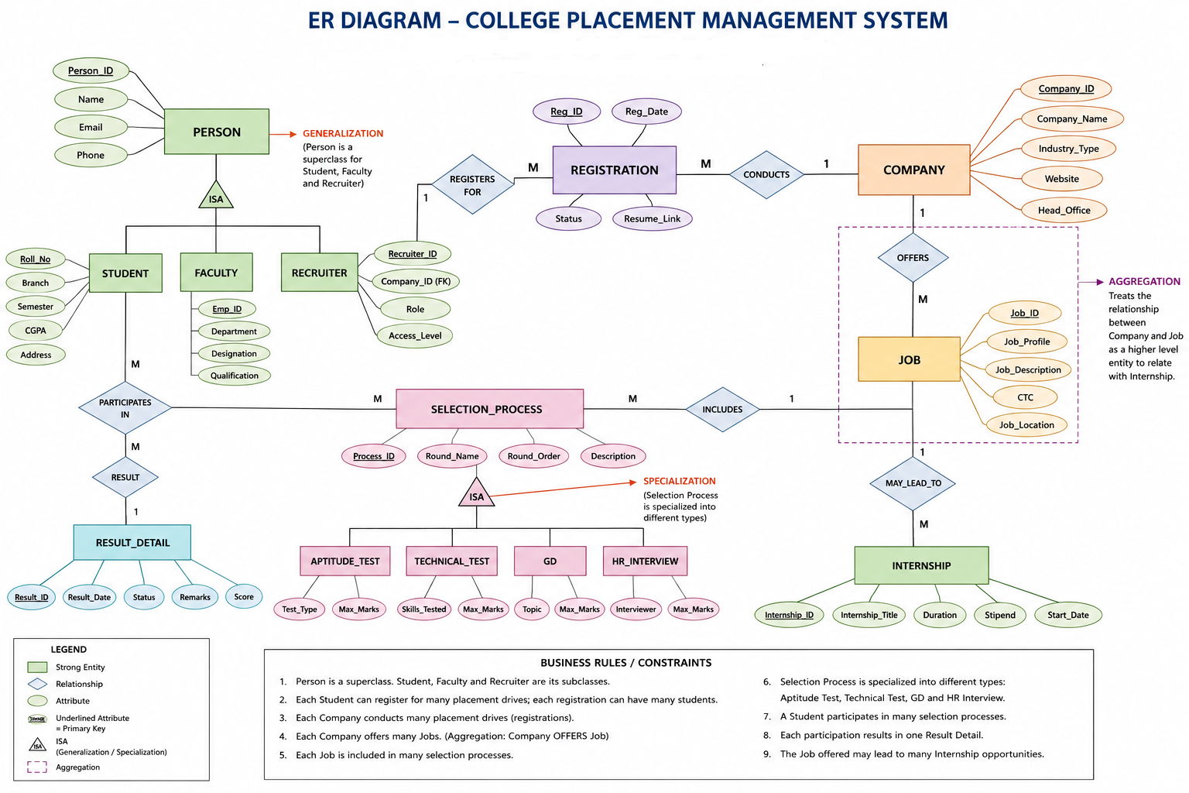
For Practice

Slide 166
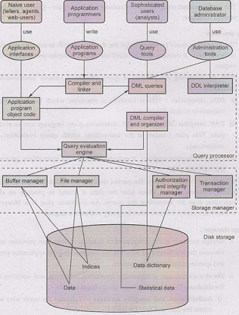
Database System Structure

Slide 167
Database System Structure
A database system is partitioned into modules that deal with each of the responsibilities of the overall system.
The functional components of a database system can be broadly divided into the storage manager and the query processor components.
1. Storage Manager
2. Query Processor

Slide 168
Storage Manager
A storage manager is a program module that provides the interface between the low level data stored in the database and the application programs and queries submitted to the system.
The storage manager is responsible for storing, retrieving, and updating data in the database.
The components of storage manager includes the following modules:

Slide 169
Authorization and integrity manager: It checks the integrity constraints and the authority of users to access data.
Transaction manager: It ensures that the database remains in a consistent (correct) state despite system failures, and that concurrent transaction executions proceed without conflicting.
File manager: It manages the allocation of space on disk storage and the data structures used to represent information stored on disk.
Buffer manager: It is responsible for fetching data from disk storage into main memory, and deciding what data to cache in main memory. The buffer manager is a critical part of the database system, since it enables the database to handle data sizes that are much larger than the size of main memory.

Slide 170
The storage manager implements several data structures as part of the physical system implementation:
• Data files, which store the database itself.
• Data dictionary, which stores metadata about the structure of the database, in particular the schema of the database.
• Indices, which provide fast access to data items that hold particular values.

Slide 171
The Query Processor
The query processor includes the following components:-
DDL interpreter: It interprets DDL statements and records the definitions in the data dictionary.
DML compiler: It translates DML statements in a query language into an evaluation plan consisting of low-level instructions that the query evaluation engine understands. The DML compiler also performs query optimization.
Query evaluation engine: It executes low-level instructions generated by the DML compiler.

Slide 172
Identify the database components
Component
Users
Application Program
DBMS
Database
Data
Hardware
Queries / Transactions
Schema (Tables)
Metadata

Slide 173
Example
Construct an E-R diagram for a car-insurance company whose customers own one or more cars each. Each car has associated with it zero to any number of recorded accidents.

Slide 174
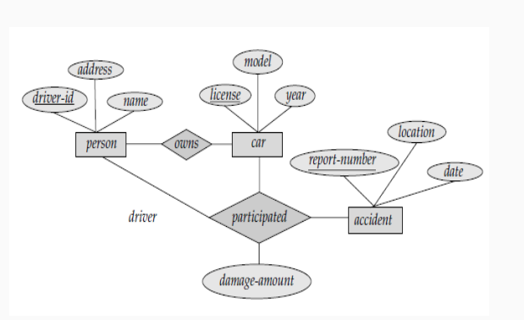

Slide 175
A university registrar’s office maintains data about the following entities:
(a) courses, including number, title, credits, syllabus, and prerequisites;
(b) course offerings, including course number, year, semester, section number, instructor(s), timings, and classroom;
(c) students, including student-id, name, and program; and
(d) instructors, including identification number, name, department, and title.
Further, the enrollment of students in courses and grades awarded to students in each course they are enrolled for must be appropriately modeled.
Construct an E-R diagram for the registrar’s office. Document all assumptions that you make about the mapping constraints.

Slide 176
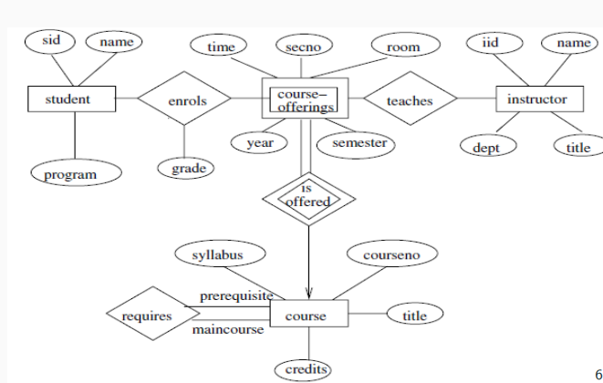

Slide 177
Case Study
A school is developing a Library Management System to maintain records of books and students. The database contains the following tables:
Books(Book_ID, Title, Author, Price)
Students(Student_ID, Name, Class)

Slide 178
Which DDL command will you use to create the Books and Students tables? Write the SQL statement for the Books table.
2. The librarian wants to add a new column Publisher to the Books table. Which DDL command should be used? Write the SQL query.
3. The school decides to rename the Students table to Library_Students. Which DDL command will you use? Write the SQL statement.
4. Before the new academic session begins, all records from the Books table need to be removed, but the table structure should remain intact. Which DDL command should be used? Explain why.

Slide 179
5. The Library_Students table is no longer required. Which DDL command will permanently remove it? What happens to the data stored in the table?
6. If the librarian wants to change the data type of the Price column from INT to DECIMAL(8,2), which DDL command should be used? Write the SQL statement.
7. A college initially created a Student table without an Email column. After one year, email IDs became mandatory. Which DDL command should the database administrator use? Justify your answer.

Slide 180
1. CREATE TABLE Books ( Book_ID INT PRIMARY KEY, Title VARCHAR(100), Author VARCHAR(100), Price DECIMAL(8,2) );
2. ALTER TABLE Books ADD Publisher VARCHAR(100);
3. ALTER TABLE Students RENAME TO Library_Students;
4. TRUNCATE TABLE Books;
5. DROP TABLE Library_Students;
6. ALTER TABLE Books MODIFY Price DECIMAL(8,2);
7. ALTER TABLE Student ADD Email VARCHAR(100);

Slide 181
Error Identification
CREATE Books (Book_ID INT, Title VARCHAR(100));
ALTER TABLE Books INSERT Publisher VARCHAR(50);
DROP Books;
TRUNCATE Books WHERE Book_ID = 10;
ALTER TABLE Student ADD COLUMN;

Slide 182
CREATE TABLE Books (Book_ID INT, Title VARCHAR(100));
ALTER TABLE Books ADD Publisher VARCHAR(50);
DROP TABLE Books;
TRUNCATE TABLE Books;
OR
DELETE FROM Books
WHERE Book_ID = 10;
ALTER TABLE Student ADD Email VARCHAR(100);

